Slide 1
Merge Sort

Slide 2
Uses divide and conquer.
First Divide repeatedly until there is only 1 element left, then compare and merge.
85721964
Divide => 8572 1964
Divide => 85 72 19 64
Divide => 8 5 7 2 1 9 6 4
Now start the sort by comparing adjacent elements and then merge.

Slide 3
k
2 | 5 | 7 | 8 | 1 | 4 | 6 | 9
i
j

Slide 5
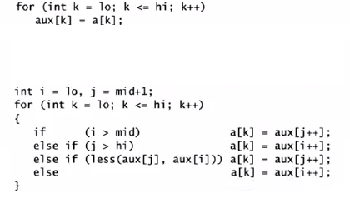
<- Copying to a temp array
<- Merging back into the original

Slide 6
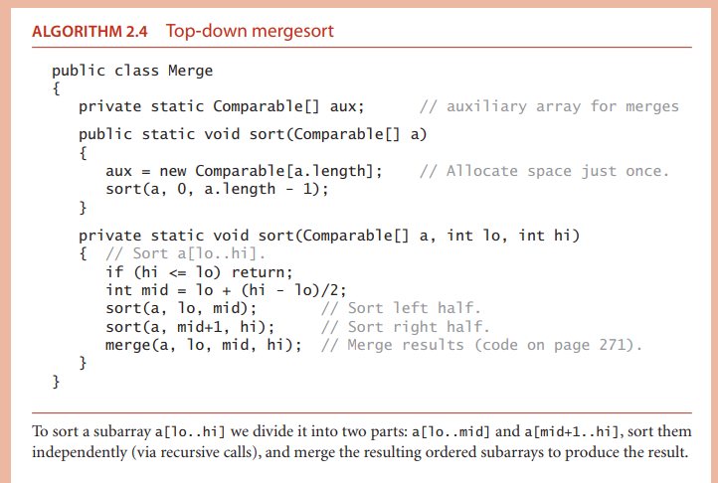

Slide 7
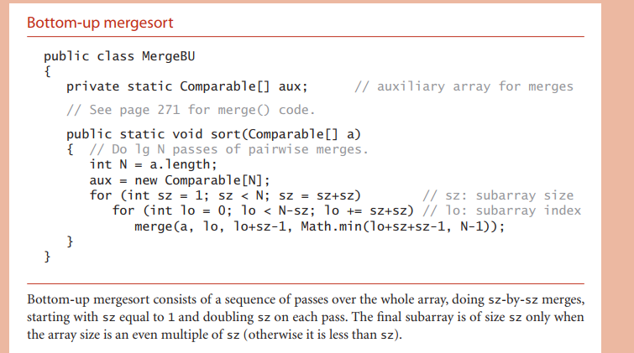

Slide 8
Top down vs Bottom up
Difference is how merge takes place.
Top down -> recursive
Bottom up -> No recursion needed

Slide 9

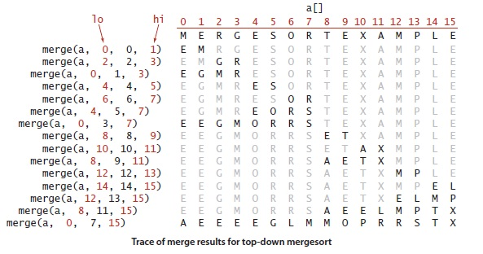

Slide 10

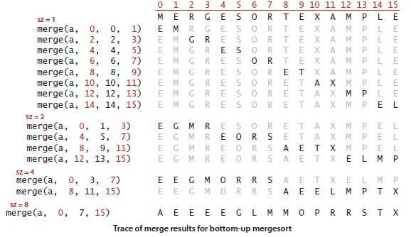

Slide 11
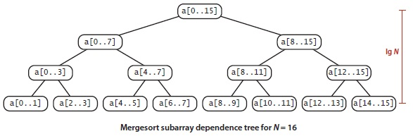
Complexity
NlogN compares
Top-down merge sort uses at most 6N log N array accesses to sort an array of length N. Each merge uses at most 6N array accesses (2N for the copy, 2N for the move back, and at most 2N for compares).

Slide 12
